Slide 1

Social Media & Analytics (Topics and User Profiles)
Team Members: Hong Kay San 116853D Lim Boon Leng 112723X

Slide 2

CONTENT
Background
Objective
Cluster Evaluation
Excel Implementation
Java Implementation
Results Analysis
Problems Encountered
Discoveries

Slide 3
Background
Forum Posts/Threads
Not well-organized
Irrelevant posts
Implemented clustering to the project
By using clustering
Reorganizes and Re-categorizes the posts
Unsupervised clustering

Slide 4
Objective
Measure the performance of the clustering algorithm
Why we want to do this
Understand clustering algorithms
How it work/process
Manual is difficult
Easier for the user

Slide 5
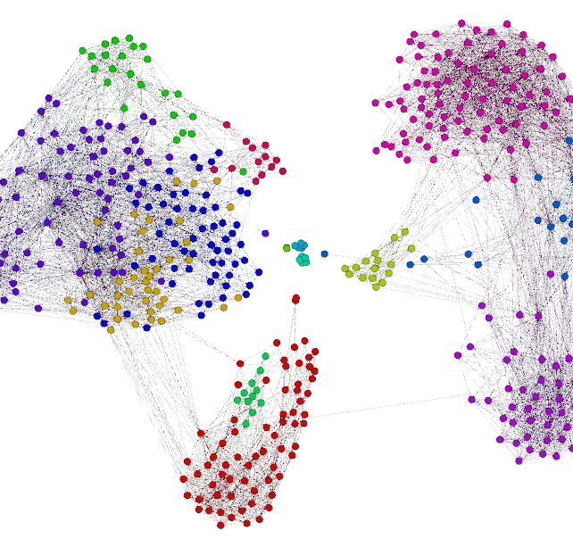
Cluster Evaluation

Slide 6
Cluster Evaluation / Validation
Cluster Evaluation
Internal
External
Internal evaluation
Cluster results evaluation based on data clustered itself
Assigns best score to algorithm producing clusters with high intra-cluster similarity, low inter-cluster similarity
External evaluation
Cluster results evaluation based on data not used for clustering
Known class labels / External benchmarks
Pre-classified items, these sets are created by humans / experts
Internal Evaluation is preferred in the case of our project scope.

Slide 7
S_Dbw Validity Index
What is S_Dbw Validity Index?
Defined based on cluster compactness and separation
Also takes into consideration the cluster densities
Measures intra-cluster variance and inter-cluster variance
Why is S_Dbw superior compared to other metrics?
Referencing from a research paper
‘Understanding of Internal Clustering Validation Measures’ [Link]

Slide 8
Implementation of S_Dbw
Tasks:
Implement formulae in Excel spreadsheet
Verification of Java implementation
Ensure accurate results
Dataset used
Dummy data of vectors with 6 dimensions
Convert mathematical formulae into working Java codes

Slide 9

Excel Implementation

Slide 10
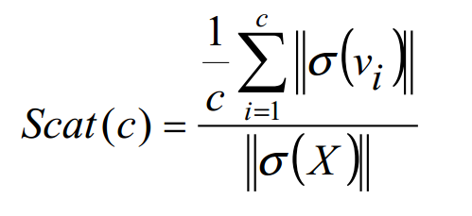
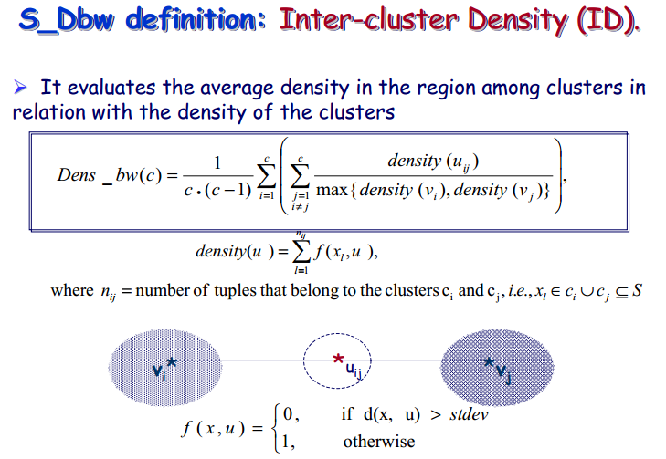
Excel Implementation
To calculate S_DBW we need:
Intra-Cluster Scatter
Inter-Cluster Density

Slide 11
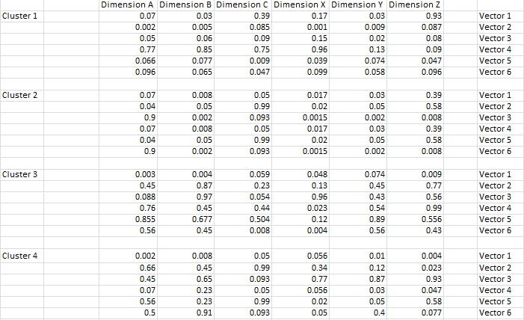
Excel Implementation
Data Set

Slide 12
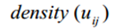
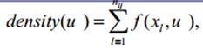
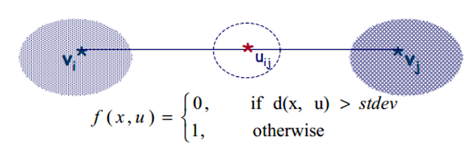
Excel Implementation
Dens_bw

Slide 13
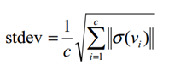
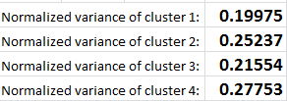
Excel Implementation
Dens_bw

Slide 14
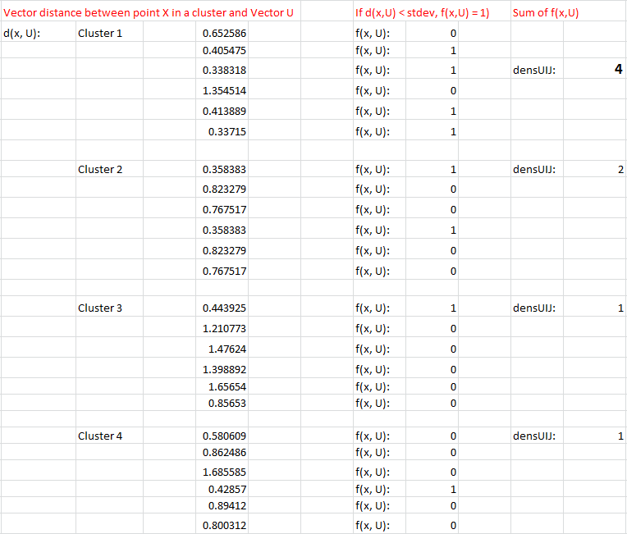
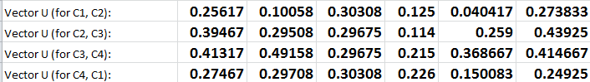
Excel Implementation
Dens_bw

Slide 15
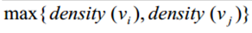
Excel Implementation
Dens_bw
Density(v )
C )

Slide 16
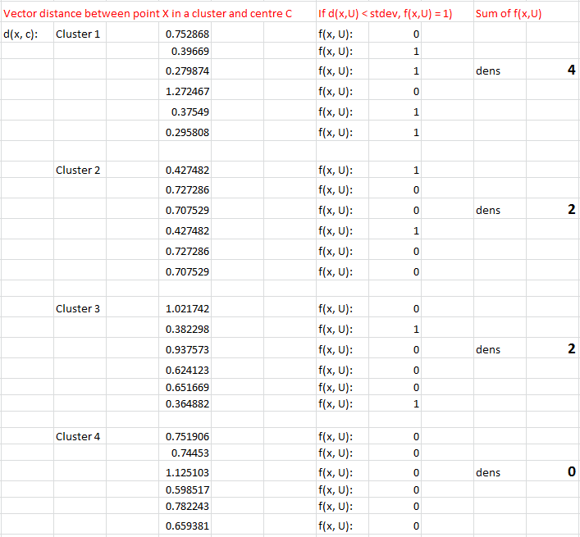
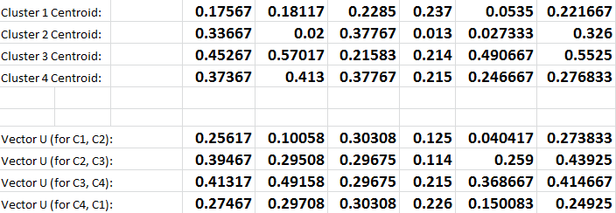
Excel Implementation
Dens_bw
Density(v )
C )

Slide 17
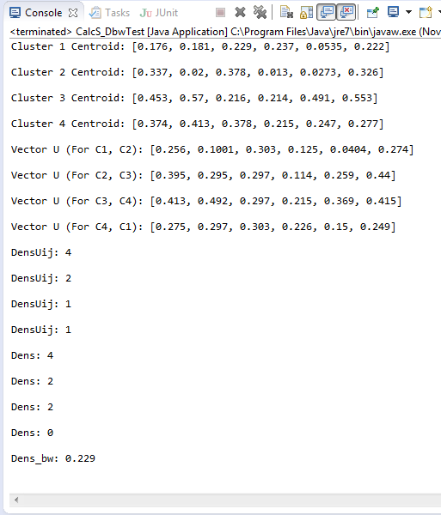
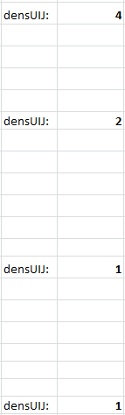
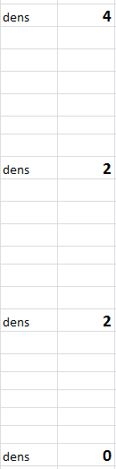
Excel Implementation
Dens_bw

Slide 18
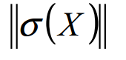
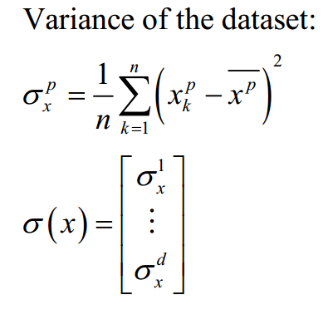
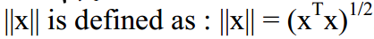
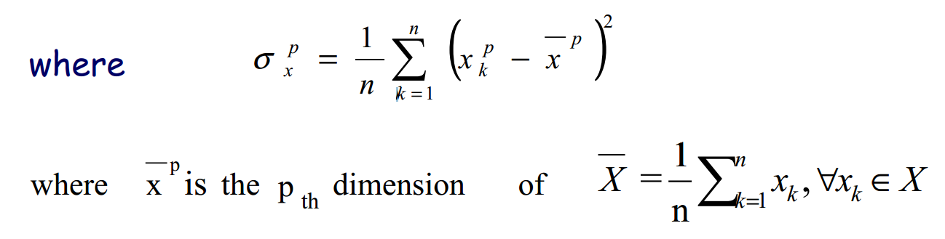
Excel Implementation
Scatter

Slide 19
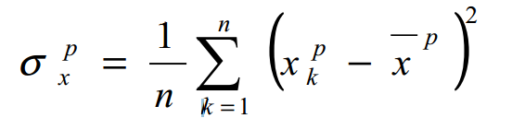
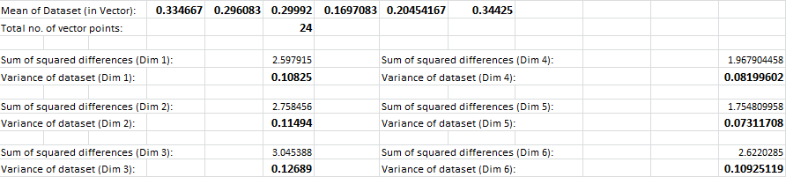
Excel Implementation
Scatter

Slide 20
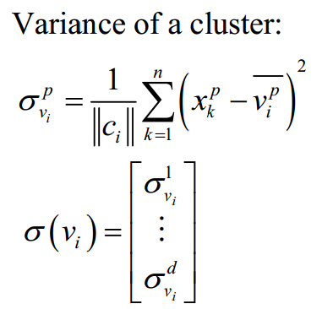
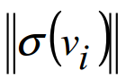
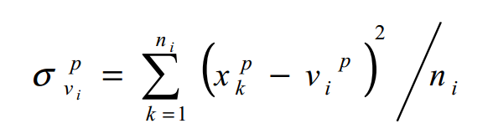
Excel Implementation
Scatter

Slide 21
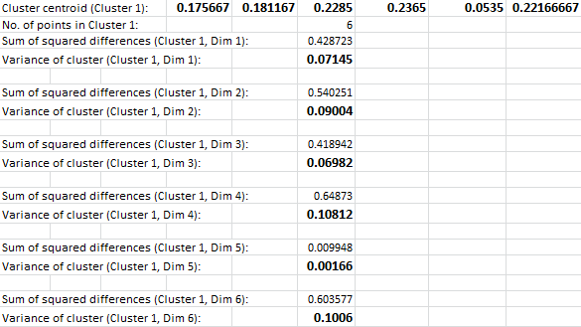
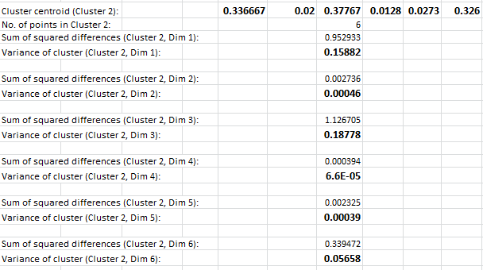
Excel Implementation
Scatter

Slide 22
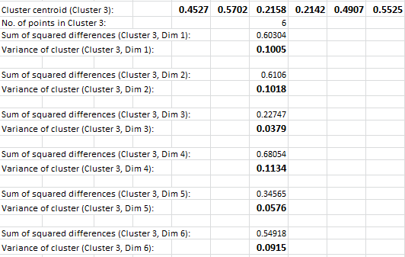
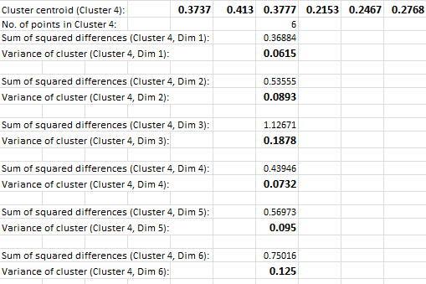
Excel Implementation
Scatter

Slide 23
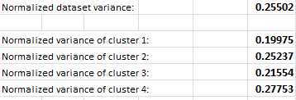
Excel Implementation
Scatter

Slide 24
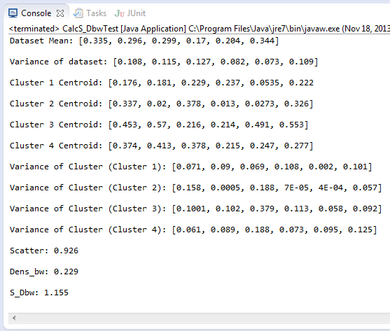
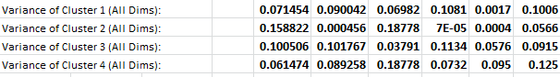
Excel Implementation
Scatter

Slide 25
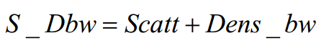
Excel Implementation
S_DBW

Slide 26

Java Implementation

Slide 27

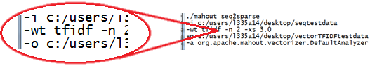
Introduction to Mahout
Mahout was used for the clustering of forum posts
Mahout’s clustering feature:
Mahout’s seq2sparse command for generating vectors:
-wt parameter (type of weight)
TF or TFIDF

Slide 28
TF V.S. TFIDF
TF vectors | Assignment of each term in a document a weight for that term, depending on the number of occurrences of the term in the document. A score between a query term t and a document d is computed, based on the weight of t in d. The simplest approach is to assign the weight to be equal to the number of occurrences of term $t$ in document $d$. This weighting scheme is referred to as term frequency
TFIDF vectors | TFIDF stands for term frequency-inverse document frequency, a numerical statistic which reflects how important a word is to a document in a collection. The TFIDF value increases proportionally to the number of times a word appears in the document, but is offset by the frequency of the word in the corpus, which helps to control for the fact that some words are generally more common than others

Slide 29
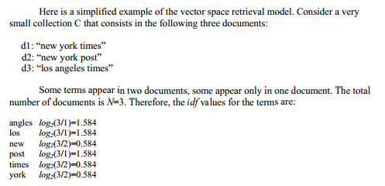
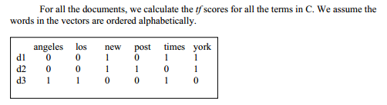
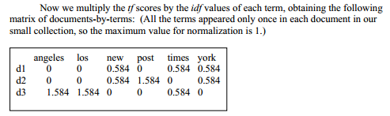
TF V.S. TFIDF (cont’d)
If term t appears in many documents, this value (idf) is low

Slide 30
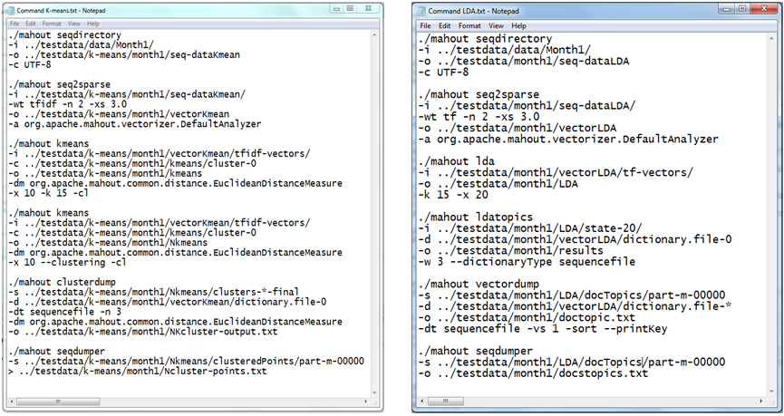
TF or TFIDF?
KMeans using TFIDF weight
LDA using TF weight
KMeans’ usage of TFIDF vectors is a must
LDA’s was not specified, but TF vectors were recommended.

Slide 31
Implementation plans
Perform LDA using TFIDF vectors on the 3 forum datasets
Raw dataset 1 (Month1) – 318 forum posts from July 2013
Raw dataset 2 (Month 6) – 1379 forum posts from January – July 2013
Raw dataset 3 (Month 12) – 2996 forum posts from July 2012 – July 2013
Evaluate performance of the clustering algorithms using S_Dbw
Results Analysis
Deduce which algorithm is the best, most suitable for clustering forum posts
Prove fact that LDA using TF outperforms LDA using TFIDF or not

Slide 32
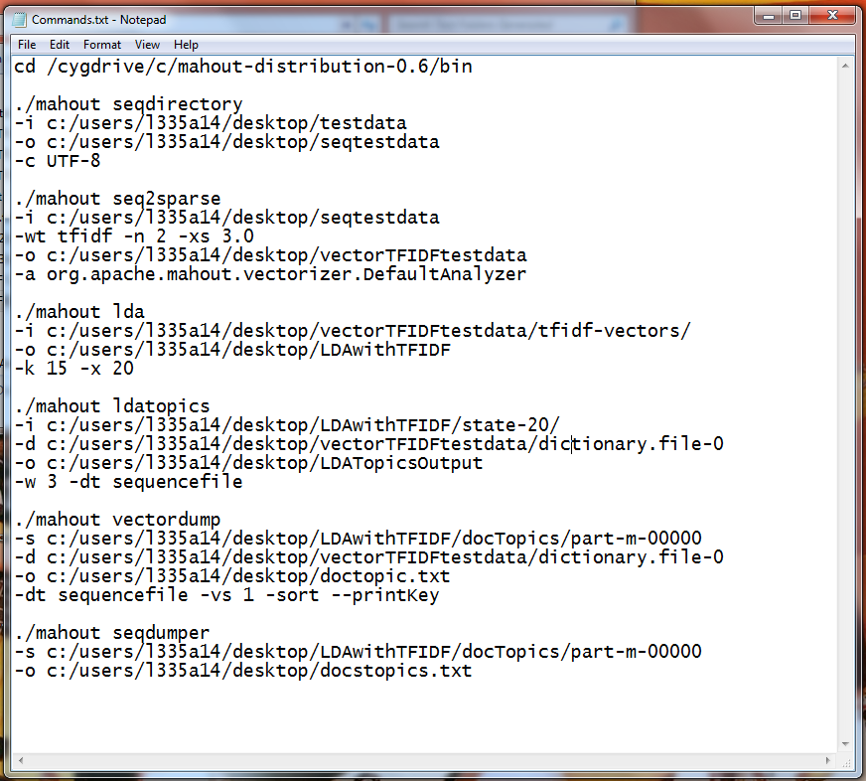
LDA with TFIDF
Convert the folder of raw data (with no sub-folders) into a Sequential File, for Mahout to process.
Convert the Sequential File into another Sequential File of TFIDF vectors, for Mahout to process.
Run LDA clustering on the TFIDF vectors, generating results of 15 clusters.
Dump the LDA clustering results of the computed topics into a folder.
Dump the vector dictionary and the cluster topics results into a single output text file, to find out which cluster each forum post belongs to.
Dump the cluster topics result Sequential File to human-readable text file

Slide 33
S_Dbw Implementation
Pre-requisites / Input required:
Vectors of equal dimensions, representing each forum post
Respective clusters that each vector belongs to
Work done:
Retrieving and formatting Mahout’s vectors
Retrieve cluster numbers stored in database for each forum post

Slide 34
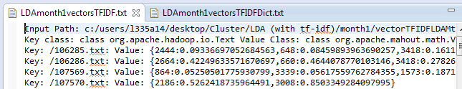
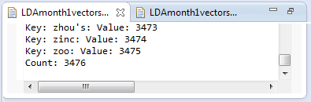
Mahout’s Output Vectors
Vectors not of equal dimensions
Requires filling up of ‘null’ vectors
Dictionary file, contains index count of all keywords generated by mahout, matched to a ID tag called Value
Vectors file also has a ID tag Value : Weight value
The vectors are a representation of the keywords in the dictionary, whereby each keyword will be assigned a weight (based on TF or TFIDF), for each input forum post.
Each keyword actually meant 1 dimension for the vector.
The missing weight values are actually 0.0 values, but omitted by Mahout.

Slide 35
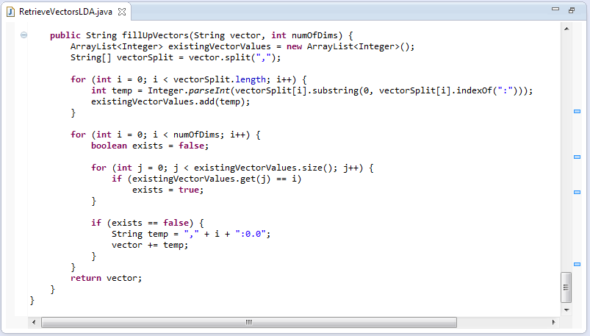
Formatting Mahout’s Vectors
The number of dimensions (dictionary file’s “Count”) were retrieved and passed as a parameter, along with the String of vector of the post.
A for loop is done to loop through each dimension of the vectors, extracting its Value ID tag, for matching to the ID tag of the word representations.
If the ID tag does not exist, assign a value of 0.0 for that ID and append to the existing vector.

Slide 36
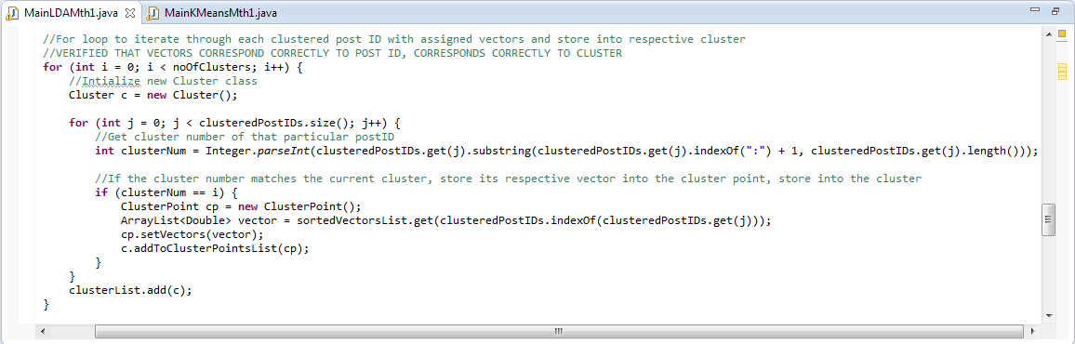
Retrieving clusters
The cluster numbers of each post is retrieved from the database and stored in an ArrayList
A for loop to iterate through the ArrayList, if the cluster number matches the current index, create a new ClusterPoint and store the respective vector of the post.
Store the created ClusterPoints into their Clusters, store the Clusters into a ClusterList
ClusterList → Input for the S_Dbw Program

Slide 37
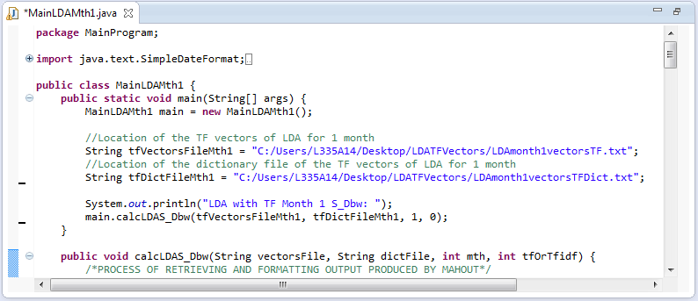
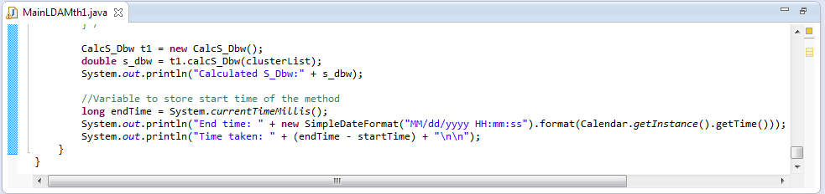
S_Dbw Program
The vectors and dictionary file used as input for creating the clusterList (after going through all the formatting and retrieving clusters)
Thereafter, clusterList is used as input for the actual S_Dbw program.

Slide 38
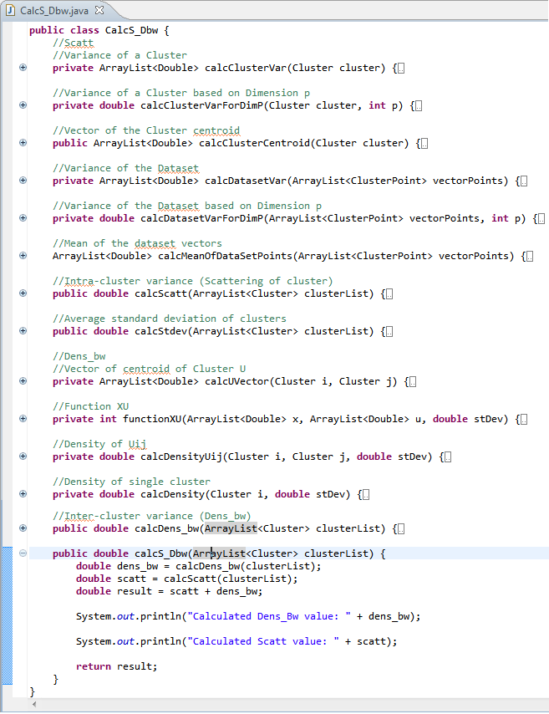
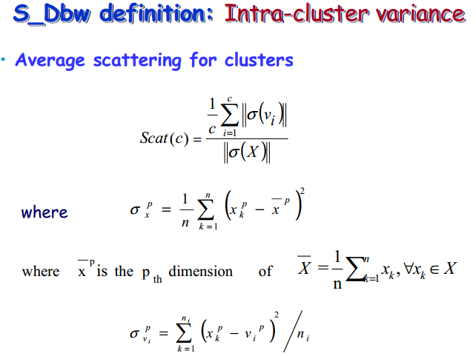
S_Dbw Program
With respect to the S_Dbw formulae, each method represents a sub-formulae, in order to compute the actual S_Dbw value.

Slide 39

Results Analysis

Slide 40
Results Analysis
S_Dbw
LDA (with tf)
LDA (with tf-idf)
KMeans
Compare
Results
For All
3 Datasets
Each of the 3 variations of cluster algorithms will be used on the 3 sets of raw data, giving an output of a total of 9 cluster outputs.
Each of the 9 cluster outputs will then be formatted as required to retrieve the necessary inputs to be passed into the calculation program to generate the S_Dbw values.

Slide 41
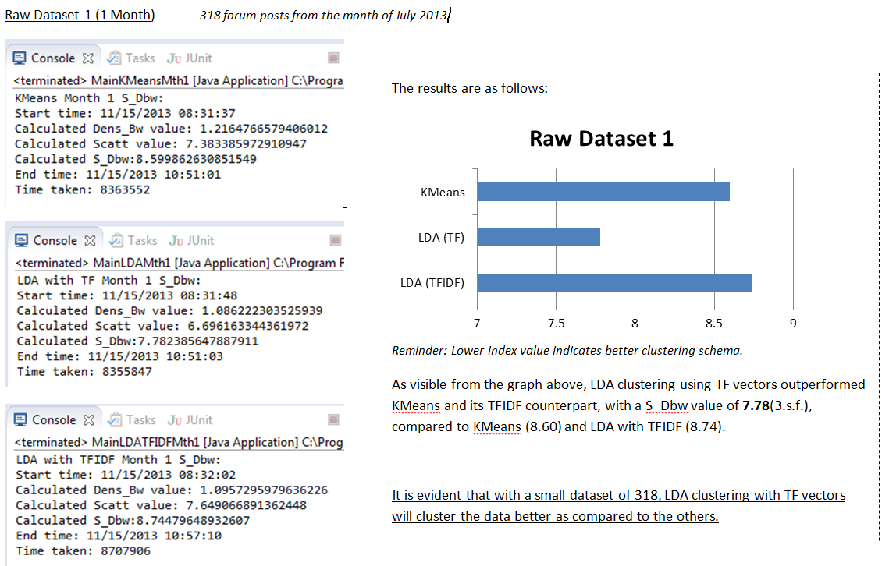
Cluster Evaluation Results

Slide 42
Problems Encountered
Instructions given by previous batch
Understanding of Clustering
R Studio
Long run hours of S_DBW program (up to days)

Slide 43
Discoveries
During the processing of raw data to sequence file to vectors, there was a phenomenon whereby there were posts without any vectors (null values for all dimensions)
Omitted / ignored
Discovery: Were forum posts with minimal text , words of no ‘importance’
Processing of raw data to sequence file to vectors is deterministic, but for the same set of vectors, LDA produces different clusters
LDA is not deterministic.
With reference to WWW, KMeans is also not deterministic.

Slide 44


